Slide 1
CANTEEN FEEDBACK
IAL

Slide 2
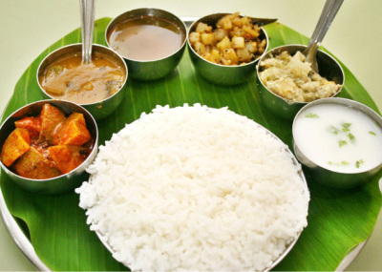


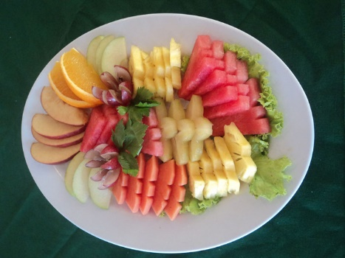



Please rate us on the following
Quality
How was the service
Variety
How was the overall experience
Taste

Slide 3
OVERALL DISTRIBUTION – HR REPORT
5
115
5
115
5
130
4
35
4
12
4
0
3
15
3
0
3
0
WASTAGES
ITEM | ACTUAL Preparation | Wastage | Unit
Lunch – Rice
100
15
KGS
Lunch – Egg
100
15
KGS
Lunch – Fruits
30
5
KGS

